Slide 1
Arrays
Single dimensional,
Multidimensional and
Jagged Array
Declaring and using ArrayList class

Slide 2
Array
Definition:
An array is a group/collection of variables of the same type that are referred to by a common name.
Arrays of any type can be created and may have one or more dimensions.
In the Java programming language, arrays are objects are dynamically created, and may be assigned to variables of type Object.
An array is a container object that holds a fixed number of values of a single type.

Slide 3
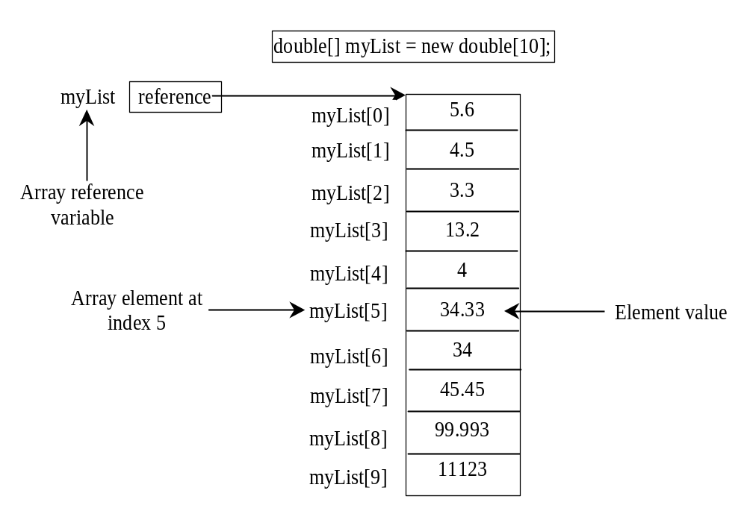
Introducing Arrays

Slide 4
Declaring Array Variables
datatype[] arrayRefVar;
Example:
double[] myList;
datatype arrayRefVar[]; // This style is //allowed, but not preferred
Example:
double myList[];

Slide 5
Creating Arrays
arrayRefVar = new datatype[arraySize];
Example:
myList = new double[10];
myList[0] references the first element in the array.
myList[9] references the last element in the array.

Slide 6
Declaring and Creating in One Step
datatype[] arrayRefVar = new
datatype[arraySize];
double[] myList = new double[10];
datatype arrayRefVar[] = new
datatype[arraySize];
double myList[] = new double[10];

Slide 7
Example
STEP 1 : (Declaration)
int marks[];
marks → null
STEP 2: (Memory Allocation)
marks = new int[5];
marks →
marks[0] marks[1] marks[2] marks[3] marks[4]
STEP 3: (Accessing Elements)
marks[0] = 10;
marks →
marks[0] marks[1] marks[2] marks[3] marks[4]
0 | 0 | 0 | 0 | 0
10 | 0 | 0 | 0 | 0

Slide 8
Size of an array can’t be changed after the array is created.
Default values:
  zero (0) for numeric data types,
  false for boolean types
  Length of an array can be obtained as: array_ref_var.length
  The array's length is available as a final instance variable length.

Slide 9
Example
class Demo_Array
{
public static void main(String args[])
{
int marks[];
marks = new int[3];
marks[0] = 10;
marks[1] = 35;
marks[2] = 84;
System.out.println(“Marks of 2nd student=” + marks[1]);
}
}

Slide 10
The Length of an Array
Once an array is created, its size is fixed. It cannot be changed. You can find its size using
    arrayRefVar.length
For example,
    myList.length returns 10

Slide 11
Indexed Variables
The array elements are accessed through the index. The array indices are 0-based, i.e., it starts from 0 to arrayRefVar.length-1. In the example in Figure , myList holds ten double values and the indices are from 0 to 9.
Each element in the array is represented using the following syntax, known as an indexed variable:
  arrayRefVar[index];
  For Example:
  myList[2] = myList[0] + myList[1];

Slide 12
Array Initializers
Declaring, creating, initializing in one step:
double[] myList = {1.9, 2.9, 3.4, 3.5};
This shorthand syntax must be in one statement.
This shorthand notation is equivalent to the following statements:
double[] myList = new double[4];
myList[0] = 1.9;
myList[1] = 2.9;
myList[2] = 3.4;
myList[3] = 3.5;

Slide 13
An Array of Characters is Not a String
In the Java programming language, unlike C, an array of char is not a String, and neither a String nor an array of char is terminated by '\u0000' (the NULL character).
A String object is immutable, that is, its contents never change, while an array of char has mutable elements.
The method toCharArray in class String returns an array of characters containing the same character sequence as a String.
The class StringBuffer implements useful methods on mutable arrays of characters.

Slide 14
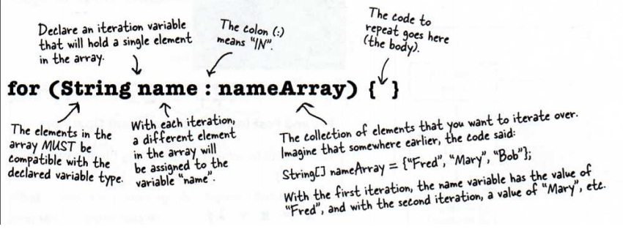
The enhanced for loop
iterates through the elements of an array or a collection without using a counter (thus avoiding the possibility of “stepping outside” the array).
The syntax of an enhanced for statement is:
for( type identifier : arrayName) { }
Ex.

Slide 15
class Myarray
{
public static void main(String [] ar)
{
int a[]= {1,2,3,4,5,6,7,8,9};
int total = 0;
for(int i : a)
total +=i;
System.out.println("sum of the elements " +total);
}
}

Slide 16
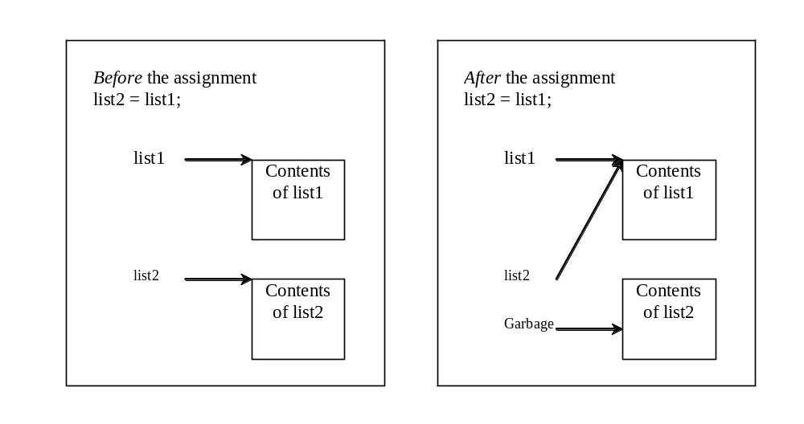
Copying Arrays
Often, in a program, you need to duplicate an array or a part of an array. In such cases you could attempt to use the assignment statement (=), as follows:
list2 = list1;

Slide 17
Copying Arrays Cont…
There are three ways to copy arrays:
  Use a loop to copy individual elements one by one.
  Use the static arraycopy method in the System class.
  Use the clone method to copy arrays;

Slide 18
Copying Arrays Cont…
Using a loop:
int[] sourceArray = {2, 3, 1, 5, 10};
int[] targetArray = new int[sourceArray.length];
for (int i = 0; i < sourceArrays.length; i++)
targetArray[i] = sourceArray[i];

Slide 19
The arraycopy Utility
arraycopy(sourceArray, src_pos, targetArray, tar_pos, length);
length -- This is the number of array elements to be copied
Example:
System.arraycopy(sourceArray, 0, targetArray, 0, sourceArray.length);

Slide 20
public class arr {
public static void main(String[] args) {
int arr1[] = { 1, 2, 3, 4, 5 };
int arr2[] = new int[arr1.length];
System.arraycopy(arr1, 0, arr2, 1, 3);
System.out.print(arr2[0] + " ");
System.out.print(arr2[1] + " ");
System.out.print(arr2[2] + " ");
System.out.print(arr2[3] + " ");
System.out.print(arr2[4] + " ");
}
}

Slide 21
The clone method
In Object class
int[] sourceArray = {2, 3, 1, 5, 10};
int[] targetArray = sourceArray.clone();

Slide 22
Passing Arrays to Methods
public static void printArray(int[] array) {
for (int i = 0; i < array.length; i++) {
System.out.print(array[i] + " ");
}
}
Invoke the method
int[] list = {3, 1, 2, 6, 4, 2};
printArray(list);
Invoke the method
printArray(new int[]{3, 1, 2, 6, 4, 2});
Anonymous array

Slide 23
Java uses pass-by-value to pass arguments to a method. There are important differences between passing the values of variables of primitive data types and passing arrays.
For an argument of a primitive type, the argument’s value is passed.
For an argument of an array type, the value of the argument is a reference to an array; this reference value is passed to the method. Semantically, it can be best described as pass-by-sharing, i.e., the array in the method is the same as the array being passed. So if you change the array in the method, you will see the change outside the method.

Slide 24
public class Test
{ public static void main(String[] args)
{ int x = 1; // x represents an int value
int[] y = new int[10]; // y represents an array of int values
m(x,y) ;
System.out.println("x is "+ x);
System.out.println("y[0] is "+ y[0]);
}
public static void m (int number , int [] numbers)
{
number = 1001;// Assign a new value to number
numbers[0] = 5555;// Assign a new value to numbers[0]
}
}

Slide 25
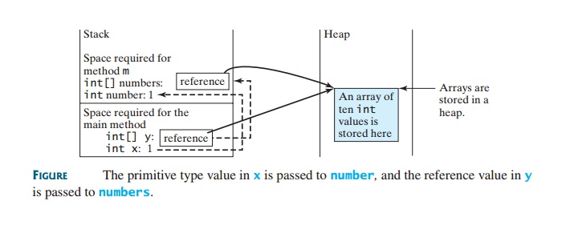

Slide 26
Returning an Array from a Method
You can pass arrays when invoking a method. A method may also return an array.
For example,
public static int[] reverse(int[] list)
{ int[] result = new int[list.length];
for(inti = 0, j = result.length - 1; i < list.length; i++, j--)
{
result[j] = list[i];
}
return result;
}
For example, the following statement returns a new array list2 with elements 6,5,4,3,2,1.
int [] list1 = {1,2,3,4,5,6};
int[] list2 = reverse(list1);

Slide 27
Multidimensional Arrays
Declare/Create Two-dimensional Arrays
// Declare array ref var
dataType[][] refVar;
// Create array and assign its reference to variable
refVar = new dataType[10][10];
// Combine declaration and creation in one statement
dataType[][] refVar = new dataType[10][10];
// Alternative syntax
dataType refVar[][] = new dataType[10][10];

Slide 28
Declaring Variables of Two-dimensional Arrays and Creating Two-dimensional Arrays
int[][] matrix = new int[10][10];
or
int matrix[][] = new int[10][10];
matrix[0][0] = 3;
for (int i = 0; i < matrix.length; i++){
for (int j = 0; j < matrix[i].length; j++){
matrix[i][j] = (int)(Math.random() * 100);
}
}

Slide 29
Declaring, Creating, and Initializing Using Shorthand Notations
int[][] array = {
{1, 2, 3},
{4, 5, 6},
{7, 8, 9},
{10, 11, 12}
};
int[][] array = new int[4][3];
array[0][0] = 1; array[0][1] = 2; array[0][2] = 3;
array[1][0] = 4; array[1][1] = 5; array[1][2] = 6;
array[2][0] = 7; array[2][1] = 8; array[2][2] = 9;
array[3][0] = 10; array[3][1] = 11; array[3][2] = 12;

Slide 30
Lengths of Two-dimensional Arrays
int[][] array = {
{1, 2, 3},
{4, 5, 6},
{7, 8, 9},
{10, 11, 12}
};
array.length
array[0].length
array[1].length
array[2].length
array[3].length
array[4].length ArrayIndexOutOfBoundsException

Slide 31
class TwoDimArr
{
public static void main(String args[])
{
int twoD[][]= new int[4][5];
int i, j, k = 0;
for(i=0; i<4; i++)
for(j=0; j<5; j++)
{
twoD[i][j] = k;
k++;
}
for(i=0; i<4; i++)
{
for(j=0; j<5; j++)
System.out.print(twoD[i][j] + " ");
System.out.println();
}
}
}

Slide 32
Jagged Arrays
Each row in a two-dimensional array is itself an array. So, the rows can have different lengths. Such an array is known as a jagged array. For example,
  int[][] matrix = {
  {1, 2, 3, 4, 5},
  {2, 3, 4, 5},
  {3, 4, 5},
  {4, 5},
  {5}
  };
matrix.length is 5
matrix[0].length is 5
matrix[1].length is 4
matrix[2].length is 3
matrix[3].length is 2
matrix[4].length is 1

Slide 33
If we don’t know the values in a ragged array in advance, but know the sizes, we can create a ragged array using the syntax that follows:
int[][] matrix = new int [5] [] ;
matrix[0] = new int[5];
matrix[1] = new int[4];
matrix[2] = new int[3];
matrix[3] = new int[2];
matrix[4] = new int[1];
You can now assign values to the array. For example,
matrix[0][3] = 50;
matrix[4][0] = 45;

Slide 34
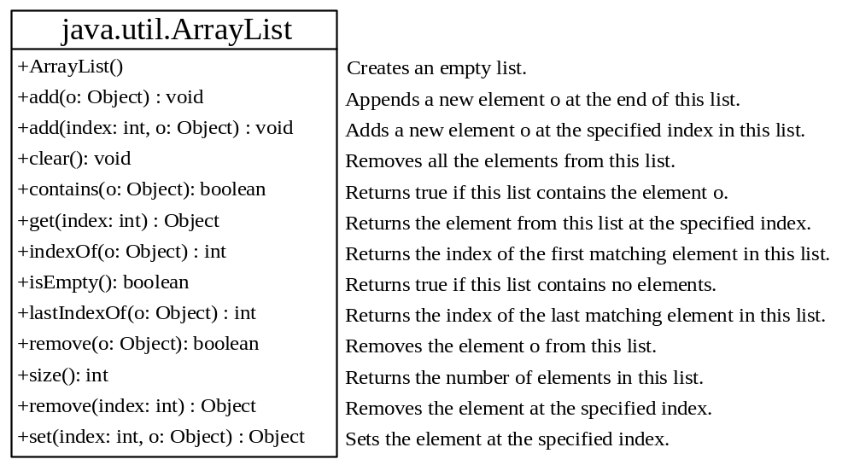
The ArrayList Class
We can create an array to store objects. But the array’s size is fixed once the array is created. Java provides the ArrayList class that can be used to store an unlimited number of objects.

Slide 35
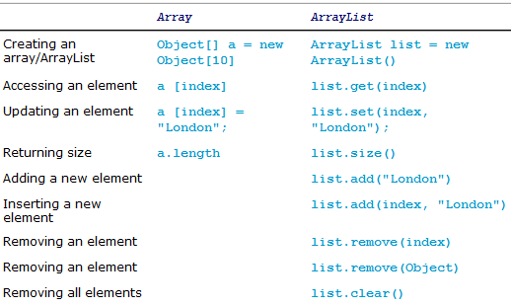
Differences and Similarity between Arrays and ArrayList

Slide 36
Differences and Similarity between Arrays and ArrayList Cont…
Once an array is created, its size is fixed.
  We can access an array element using the square bracket notation (e.g., a[index]).
When an ArrayList is created, its size is 0.
  We cannot use the get and set method if the element is not in the list.
It is easy to add, insert, and remove elements in a list, but it is rather complex to add, insert, and remove elements in an array.
We have to write the code to manipulate the array in order to perform these operations

Slide 37
public class AL {
public static void main(String args[])
{
ArrayList al = new ArrayList();
System.out.println("size is" + al.size());
System.out.println("Contents of al: " + al);
/*al.add("A");
System.out.println("size is" + al.size());
System.out.println("Contents of al: " + al);*/
/*al.add("B");
al.add("C");
al.add("D");
System.out.println("size is" + al.size());
System.out.println("Contents of al: " + al);*/
/*al.add(2, "B2");
al.add(7);
System.out.println("Size is" + al.size());
System.out.println("Contents of al: " + al);*/
/*System.out.println("element present at index position " + al.get(3));
System.out.println("Size is" + al.size());
System.out.println("Contents of al: " + al);*/
/*System.out.println("replacing.....");
al.set(3,"C1");
System.out.println("Size is" + al.size());
System.out.println("Contents of al: " + al);/*
//System.out.println("List contains "+ al.contains("C1"));
//System.out.println("index is "+ al.indexOf("B2"));
//System.out.println("List is empty? "+ al.isEmpty());
// Remove elements from the array list
/*al.remove("B2");
System.out.println("Size after first removal " + al.size());
System.out.println("Contents of al: " + al);*/
/* al.remove(3);
System.out.println("Size after second removal " + al.size());
System.out.println("Contents of al: " + al);*/
/* al.clear();
System.out.println("Size of all removal " + al.size());
System.out.println("Contents of al: " + al);*/
}
}

Slide 38
import java.util.ArrayList;
class Box {
private double width;
private double height;
private double depth;
Box(Box ob) { // pass object to constructor
width = ob.width;
height = ob.height;
depth = ob.depth;
}
Box(double w, double h, double d) {
width = w;
height = h;
depth = d;
}
Box() {
width = -1; // use -1 to indicate
height = -1; // an uninitialized
depth = -1; // box
}
Box(double len) {
width = height = depth = len;
}
double volume() {
return width * height * depth;
}
}

Slide 39
public class TestArrayList
{
public static void main(String[] args)
{
// Create a list to store cities
java.util.ArrayList cityList = new java.util.ArrayList();
// Add some cities in the list
cityList.add("London");
// cityList now contains [London]
cityList.add("Denver");
// cityList now contains [London, Denver]
cityList.add("Paris");
// cityList now contains [London, Denver, Paris]
cityList.add("Miami");
// cityList now contains [London, Denver, Paris, Miami]
cityList.add("Seoul");
// contains [London, Denver, Paris, Miami, Seoul]
cityList.add("Tokyo");
// contains [London, Denver, Paris, Miami, Seoul, Tokyo]

Slide 40
System.out.println("List size? "+ cityList.size());
System.out.println("Is Miami in the list? " +cityList.contains("Miami") );
System.out.println("The location of Denver in the list?" + cityList.indexOf("Denver"));
System.out.println("The location of Uk in the list?" + cityList.indexOf("Uk"));
System.out.println("Is the list empty? " +cityList.isEmpty() ); // Print false
// Insert a new city at index 2
cityList.add(2, "Xian");
// contains [London, Denver, Xian, Paris, Miami, Seoul, Tokyo]
// Remove a city from the list
cityList.remove("Miami");
// contains [London, Denver, Xian, Paris, Seoul, Tokyo]

Slide 41
// Remove a city at index 1
cityList.remove(1);
// contains [London, Xian, Paris, Seoul, Tokyo]
// Display the contents in the list
System.out.println(cityList.toString()); /*for(String name : cityList)
{ System.out.println(name);
}*/
// Display the contents in the list in reverse order
for (int i = cityList.size() - 1; i >= 0; i--)
System.out.print(cityList.get(i) + " ");
System.out.println();
// Create a list to store two bOX
java.util.ArrayList list = new java.util.ArrayList();
// Add two bOX
list.add(new Box(2));
list.add(new Box(3));
// Display the area of the first box in the list
System.out.println("The Volume of the Box? " + ((Box)list.get(0)).volume());
}
}

Slide 42
Practice Question:
WAP which prompts the user to enter the number of subjects, their marks of Academic Tasks and store them into a Jagged Array. Now write a method to display the grades of any given subject.
WAP to create an ArrayList which can store object of a class person. Person class has a name, age, address, and phone_no. Create two methods in person class one for taking values of all the fields of a Person from the user and one for displaying these values. Add 3 objects of type person in the ArrayList. How do you find the number of objects in a list? How do you remove a given object from a list? How do you remove the last object from the list? How do you check whether a given object is in a list? How do you retrieve an object at a specified index from a list? Display all the fields of any person objects which is present in the ArrayList

